Slide 1

Software Engineering
CS-328
Software Testing
Rubab Jaffar

Slide 2
Topics covered
Development testing
Test-driven development
Release testing
User testing
Notes:
Testing MCQs
https://www.softwaretestinghelp.com/istqb-exam-questions-equivalence-partitioning-boundary-value-analysis/

Slide 3
SCOPE
SW
Project
Deployment
Planning
UAT
Requirements
Operation
Analysis
Maintenance
Design
Development
Built
Release
Testing

Slide 4
What Testing Shows
errors
requirements conformance
performance
an indication
of quality

Slide 5
Software testing- Definition
Testing is the process of evaluating a system or its component(s) with the intent to find whether it satisfies the specified requirements or not.
Software testing is a process of analyzing or operating software for the purpose of finding bugs.
Software testing is the process of testing the functionality and correctness of software by running it.
Software testing is usually performed for one of two reasons:
Defect detection
Reliability estimation

Slide 6
Why Software Testing?
An investigation conducted to provide stakeholders with information about the quality of the software under test.
To detect failures so that defects may be discovered and corrected.
Testing cannot establish that a product functions properly under all conditions; but can only establish that it does not function properly under specific conditions
Notes:
Limitation of testing = scenarios that has been tested

Slide 7
Testing criteria
It is a process of executing a program/ application under positive and negative conditions by manual and automated means. Testing should help locate errors, not just detect their presence
a “yes/no” answer to the question “is the program correct?” is not very helpful
Testing should be repeatable
It checks for the
Specification
Performance
Functionality

Slide 8
Manual Testing
Manual testing includes testing a software manually, i.e., without using any automated tool or any script. In this type, the tester takes over the role of an end-user and tests the software to identify any unexpected behavior or bug.
Testers use test plans, test cases, or test scenarios to test a software to ensure the completeness of testing.

Slide 9

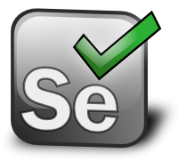
Automation Testing
When the tester writes scripts and uses it to test the product. This process involves automation of a manual process.
Automation Testing is used to re-run the test scenarios that were performed manually, quickly, and repeatedly.
If a manual test costs $X to run the first time, it will cost $X to run every time thereafter.
An automated test can cost 3 to 30 times $X the first time, but will cost about $0 after that.

Slide 10
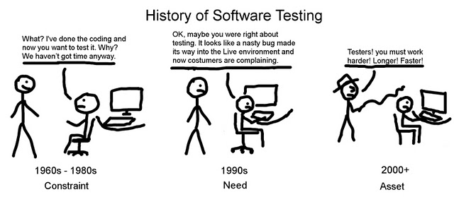

Slide 11
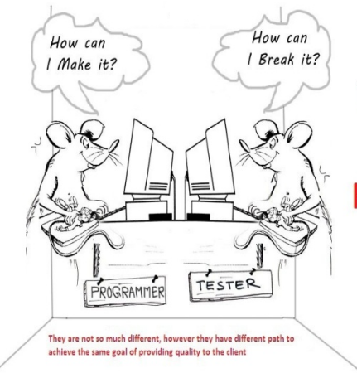
Development Vs Testing

Slide 12
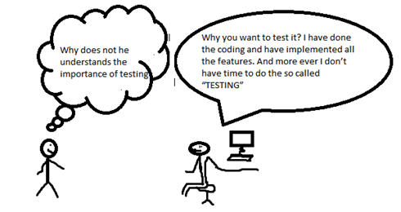
Development Vs Testing

Slide 13
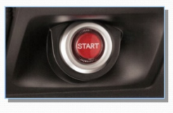
When to Start / Stop Testing?
An early start to testing reduces the cost and time to rework and produce error-free software that is delivered to the client. However in Software Development Life Cycle (SDLC), testing can be started from the Requirements Gathering phase and continued till the deployment of the software. It also depends on the development model that is being used.

Slide 14


When to Start / Stop Testing?

Slide 15
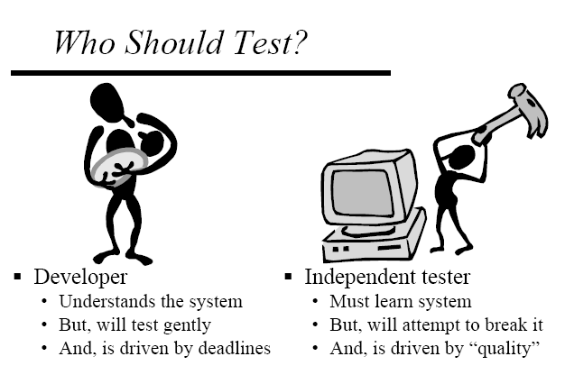
The role of the independent tester is to remove the conflict of interest inherent when the builder is testing his or her own product.

Slide 16
When to Stop Testing?
It is difficult to determine when to stop testing, as testing is a never-ending process and no one can claim that a software is 100% tested.
Testing Deadlines
Completion of test case execution
Completion of function to a certain point
Bug rate falls below a certain level and no high-priority bugs are identified
Management decision

Slide 17
Program Testing
Testing is intended to show that a program does what it is intended to do and to discover program defects before it is put into use.
When you test software, you execute a program using artificial data.
You check the results of the test run for errors, anomalies or information about the program’s non-functional attributes.
Can reveal the presence of errors NOT their absence.
Testing is part of a more general verification and validation process, which also includes static validation techniques.

Slide 18
Program Testing Goals
To demonstrate to the developer and the customer that the software meets its requirements.
For custom software, this means that there should be at least one test for every requirement in the requirements document. For generic software products, it means that there should be tests for all of the system features, plus combinations of these features, that will be incorporated in the product release.
To discover situations in which the behavior of the software is incorrect, undesirable or does not conform to its specification.
Defect testing is concerned with rooting out undesirable system behavior such as system crashes, unwanted interactions with other systems, incorrect computations and data corruption.

Slide 19
Validation and Defect Testing
The first goal leads to validation testing
You expect the system to perform correctly using a given set of test cases that reflect the system’s expected use.
The second goal leads to defect testing
The test cases are designed to expose defects. The test cases in defect testing can be deliberately obscure and need not reflect how the system is normally used.

Slide 20
Testing Process Goals
Validation testing
To demonstrate to the developer and the system customer that the software meets its requirements
A successful test shows that the system operates as intended.
Defect testing
To discover faults or defects in the software where its behaviour is incorrect or not in conformance with its specification
A successful test is a test that makes the system perform incorrectly and so exposes a defect in the system.

Slide 21
An Input-output Model of Program Testing

Slide 22
Verification vs Validation
Verification: "Are we building the product right”.
The software should conform to its specification.
Validation: "Are we building the right product”.
The software should do what the user really requires.

Slide 23
V & V Confidence
Aim of V & V is to establish confidence that the system is ‘fit for purpose’.
Depends on system’s purpose, user expectations and marketing environment
Software purpose
The level of confidence depends on how critical the software is to an organisation.
User expectations
Users may have low expectations of certain kinds of software.
Marketing environment
Getting a product to market early may be more important than finding defects in the program.

Slide 24
Inspections and Testing
Software inspections Concerned with analysis of the static system representation to discover problems (static verification)
May be supplement by tool-based document and code analysis.
Software testing Concerned with exercising and observing product behaviour (dynamic verification)
The system is executed with test data and its operational behaviour is observed.

Slide 25
Inspections and Testing

Slide 26
Software Inspections
These involve people examining the source representation with the aim of discovering anomalies and defects.
Inspections not require execution of a system so may be used before implementation.
They may be applied to any representation of the system (requirements, design, configuration data, test data, etc.).
They have been shown to be an effective technique for discovering program errors.

Slide 27
Advantages of Inspections
During testing, errors can mask (hide) other errors. Because inspection is a static process, you don’t have to be concerned with interactions between errors.
Incomplete versions of a system can be inspected without additional costs. If a program is incomplete, then you need to develop specialized test harnesses to test the parts that are available.
As well as searching for program defects, an inspection can also consider broader quality attributes of a program, such as compliance with standards, portability and maintainability.

Slide 28
Inspections and Testing
Inspections and testing are complementary and not opposing verification techniques.
Both should be used during the V & V process.
Inspections can check conformance with a specification but not conformance with the customer’s real requirements.
Inspections cannot check non-functional characteristics such as performance, usability, etc.

Slide 29
A model of the Software Testing Process

Slide 30
Stages of Testing
Development testing, where the system is tested during development to discover bugs and defects.
Release testing, where a separate testing team test a complete version of the system before it is released to users.
User testing, where users or potential users of a system test the system in their own environment.

Slide 31
Development Testing

Slide 32
Development Testing
Development testing includes all testing activities that are carried out by the team developing the system.
Unit testing, where individual program units or object classes are tested. Unit testing should focus on testing the functionality of objects or methods.
Component testing, where several individual units are integrated to create composite components. Component testing should focus on testing component interfaces.
System testing, where some or all of the components in a system are integrated and the system is tested as a whole. System testing should focus on testing component interactions.

Slide 33
Unit Testing
Unit testing is the process of testing individual components in isolation.
It is a defect testing process.
Units may be:
Individual functions or methods within an object
Object classes with several attributes and methods
Composite components with defined interfaces used to access their functionality.

Slide 34
Object Class Testing
Complete test coverage of a class involves
Testing all operations associated with an object
Setting and interrogating all object attributes
Exercising the object in all possible states.
Inheritance makes it more difficult to design object class tests as the information to be tested is not localised.

Slide 35
The Weather Station Object Interface

Slide 36
Weather station state diagram

Slide 37
Weather Station Testing
Need to define test cases for reportWeather, calibrate, test, startup and shutdown.
Using a state model, identify sequences of state transitions to be tested and the event sequences to cause these transitions
For example:
Shutdown -> Running-> Shutdown
Configuring-> Running-> Testing -> Transmitting -> Running
Running-> Collecting-> Running-> Summarizing -> Transmitting -> Running

Slide 38
Automated Testing
Whenever possible, unit testing should be automated so that tests are run and checked without manual intervention.
In automated unit testing, you make use of a test automation framework (such as JUnit) to write and run your program tests.
Unit testing frameworks provide generic test classes that you extend to create specific test cases. They can then run all of the tests that you have implemented and report, often through some GUI, on the success of otherwise of the tests.

Slide 39
Automated Test Components
A setup part, where you initialize the system with the test case, namely the inputs and expected outputs.
A call part, where you call the object or method to be tested.
An assertion part where you compare the result of the call with the expected result. If the assertion evaluates to true, the test has been successful if false, then it has failed.

Slide 40
Choosing Unit Test Cases
The test cases should show that, when used as expected, the component that you are testing does what it is supposed to do.
If there are defects in the component, these should be revealed by test cases.
This leads to 2 types of unit test case:
The first of these should reflect normal operation of a program and should show that the component works as expected.
The other kind of test case should be based on testing experience of where common problems arise. It should use abnormal inputs to check that these are properly processed and do not crash the component.

Slide 41
Testing Strategies
Partition testing, where you identify groups of inputs that have common characteristics and should be processed in the same way.
You should choose tests from within each of these groups.
Guideline-based testing, where you use testing guidelines to choose test cases.
These guidelines reflect previous experience of the kinds of errors that programmers often make when developing components.

Slide 42
Partition Testing
Input data and output results often fall into different classes where all members of a class are related.
Each of these classes is an equivalence partition or domain where the program behaves in an equivalent way for each class member.
Test cases should be chosen from each partition.

Slide 43
Equivalence Partitioning

Slide 44
Equivalence Partitions

Slide 45
Testing Guidelines (sequences)
Test software with sequences which have only a single value.
Use sequences of different sizes in different tests.
Derive tests so that the first, middle and last elements of the sequence are accessed.
Test with sequences of zero length.

Slide 46
General Guidelines Based Testing
Choose inputs that force the system to generate all error messages
Design inputs that cause input buffers to overflow
Repeat the same input or series of inputs numerous times
Force invalid outputs to be generated
Force computation results to be too large or too small.

Slide 47
Component Testing
Software components are often composite components that are made up of several interacting objects.
For example, in the weather station system, the reconfiguration component includes objects that deal with each aspect of the reconfiguration.
You access the functionality of these objects through the defined component interface.
Testing composite components should therefore focus on showing that the component interface behaves according to its specification.
You can assume that unit tests on the individual objects within the component have been completed.

Slide 48
Interface Testing
Objectives are to detect faults due to interface errors or invalid assumptions about interfaces.
Interface types
Parameter interfaces Data passed from one method or procedure to another.
Shared memory interfaces Block of memory is shared between procedures or functions.
Procedural interfaces Sub-system encapsulates a set of procedures to be called by other sub-systems. Objects and reusable components have this form of interface.
Message passing interfaces Sub-systems request services from other sub-systems. A return message includes the results of executing the service. Some object-oriented systems have this form of interface, as do client–server systems.

Slide 49
Interface Testing

Slide 50
Interface Errors
Interface misuse
A calling component calls another component and makes an error in its use of its interface e.g. parameters in the wrong order.
Interface misunderstanding
A calling component embeds assumptions about the behaviour of the called component which are incorrect. For example, a binary search method may be called with a parameter that is an unordered array.
Timing errors
The called and the calling component operate at different speeds and out-of-date information is accessed.

Slide 51
Interface Testing Guidelines
Design tests so that parameters to a called procedure are at the extreme ends of their ranges.
Always test pointer parameters with null pointers.
Design tests which cause the component to fail.
Use stress testing in message passing systems.
In shared memory systems, vary the order in which components are activated.

Slide 52
System Testing
System testing during development involves integrating components to create a version of the system and then testing the integrated system.
The focus in system testing is testing the interactions between components.
System testing checks that components are compatible, interact correctly and transfer the right data at the right time across their interfaces.
System testing tests the emergent behaviour of a system.

Slide 53
System and Component Testing
During system testing, reusable components that have been separately developed and off-the-shelf systems may be integrated with newly developed components. The complete system is then tested.
Components developed by different team members or sub-teams may be integrated at this stage. System testing is a collective rather than an individual process.
In some companies, system testing may involve a separate testing team with no involvement from designers and programmers.

Slide 54
Use-case Testing
The use-cases developed to identify system interactions can be used as a basis for system testing.
Each use case usually involves several system components so testing the use case forces these interactions to occur.
The sequence diagrams associated with the use case documents the components and interactions that are being tested.
Notes:
Interaction testing

Slide 55
Collect Weather Data Sequence Chart

Slide 56
Test cases Derived from Sequence Diagram
An input of a request for a report should have an associated acknowledgement. A report should ultimately be returned from the request.
You should create summarized data that can be used to check that the report is correctly organized.
An input request for a report to WeatherStation results in a summarized report being generated.
Can be tested by creating raw data corresponding to the summary that you have prepared for the test of SatComms and checking that the WeatherStation object correctly produces this summary. This raw data is also used to test the WeatherData object.

Slide 57
Testing Policies
Exhaustive system testing is impossible so testing policies which define the required system test coverage may be developed.
Examples of testing policies:
All system functions that are accessed through menus should be tested.
Combinations of functions (e.g. text formatting) that are accessed through the same menu must be tested.
Where user input is provided, all functions must be tested with both correct and incorrect input.

Slide 58
Test-driven Development

Slide 59
Test-driven Development
Test-driven development (TDD) is an approach to program development in which you inter-leave testing and code development.
Tests are written before code and ‘passing’ the tests is the critical driver of development.
You develop code incrementally, along with a test for that increment. You don’t move on to the next increment until the code that you have developed passes its test.
TDD was introduced as part of agile methods such as Extreme Programming. However, it can also be used in plan-driven development processes.

Slide 60
Test-driven Development

Slide 61
TDD Process Activities
Start by identifying the increment of functionality that is required. This should normally be small and implementable in a few lines of code.
Write a test for this functionality and implement this as an automated test.
Run the test, along with all other tests that have been implemented. Initially, you have not implemented the functionality so the new test will fail.
Implement the functionality and re-run the test.
Once all tests run successfully, you move on to implementing the next chunk of functionality.

Slide 62
Benefits of Test-driven Development
Code coverage
Every code segment that you write has at least one associated test so all code written has at least one test.
Regression testing
A regression test suite is developed incrementally as a program is developed.
Simplified debugging
When a test fails, it should be obvious where the problem lies. The newly written code needs to be checked and modified.
System documentation
The tests themselves are a form of documentation that describe what the code should be doing.

Slide 63
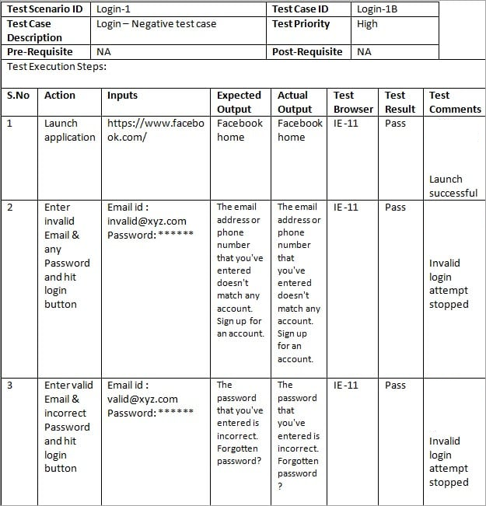

Slide 64
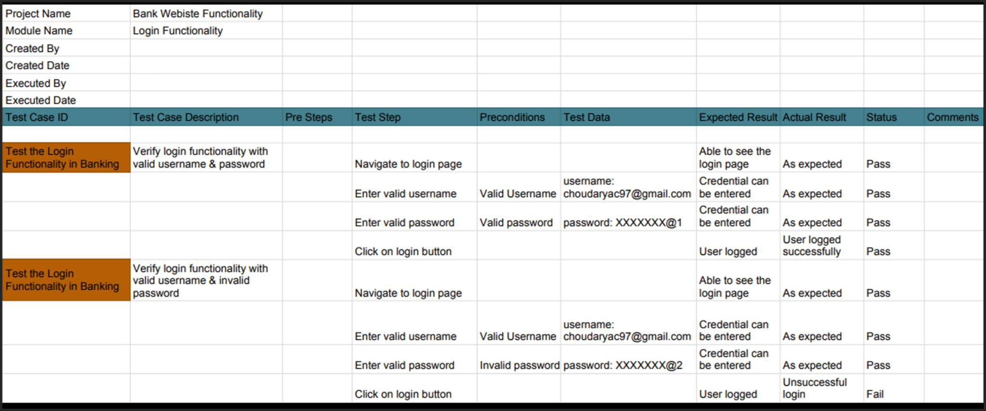

Slide 65
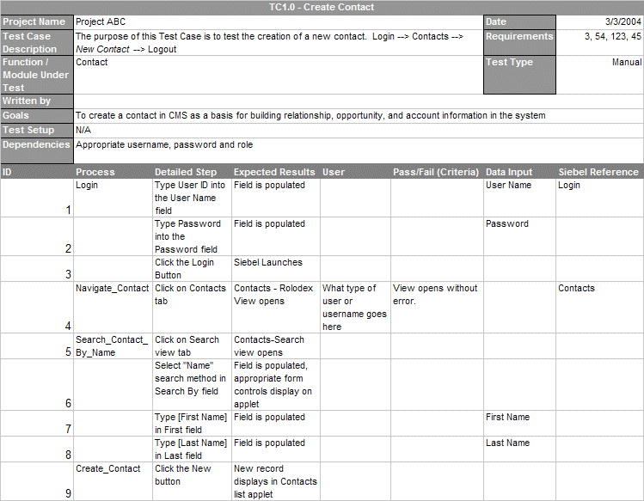

Slide 66
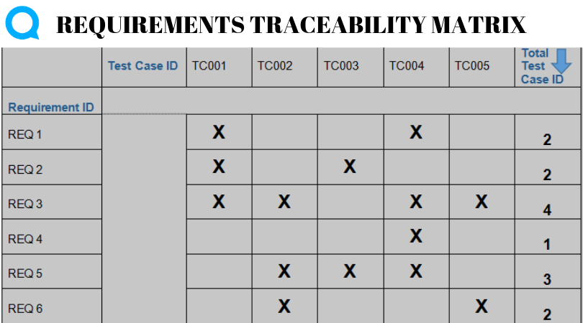

Slide 67
Regression Testing
Regression testing is testing the system to check that changes have not ‘broken’ previously working code.
In a manual testing process, regression testing is expensive but, with automated testing, it is simple and straightforward. All tests are rerun every time a change is made to the program.
Tests must run ‘successfully’ before the change is committed.

Slide 68
Path Testing
The objective of path testing is to ensure that the set of test cases is such that each path through the program is executed at least once.
The starting point for path testing is a program flow graph that shows nodes representing program decisions and arcs representing the flow of control.
Statements with conditions are therefore nodes in the flow graph.
Notes:
Furthermore, all conditional statements are tested for both true and false cases. The number of paths through a program is usually proportional to its size. As modules
are integrated into systems, it becomes unfeasible to use structural testing techniques. Path testing techniques are therefore mostly used during component testing.

Slide 69
Steps for Basis Path testing
The basic steps involved in basis path testing include
Draw a control graph (to determine different program paths)
Find a basis set of paths
Generate test cases to exercise each path

Slide 70
public static void search ( int key, int 0elemArray, Result r )
{
1. int bottom =0 ;
2. int top =elemArray.length - 1 ; int mid;
3. r.found =false ;
4. r.index =-1 ;
5. while ( bottom <= top )
{
6 mid =(top + bottom) / 2 ;
7 if (elemArray [mid] = key)
{
8 rindex = mid;
9 r.found =true ;
10 return ; } // if part
else
{
11 if (elemArray [mid] < key)
12 bottom = mid + 1 ;
else
13 top = mid - 1 ; }
} //while loop
14. } //search

Slide 71
Binary Search Flow Graph

Slide 72
Independent Paths
1, 2, 3, 4, 5, 6, 7, 8, 9, 10, 14
1, 2, 3, 4, 5, 14
1, 2, 3, 4, 5, 6, 7, 11, 12, 5, …
1, 2, 3, 4, 5, 6, 7, 11, 13, 5, …
Test cases should be derived so that all of these paths are executed
A dynamic program analyser may be used to check that paths have been executed

Slide 73
Release Testing

Slide 74
Release Testing
Release testing is the process of testing a particular release of a system that is intended for use outside of the development team.
The primary goal of the release testing process is to convince the supplier of the system that it is good enough for use.
Release testing, therefore, has to show that the system delivers its specified functionality, performance and dependability, and that it does not fail during normal use.
Release testing is usually a black-box testing process where tests are only derived from the system specification.

Slide 75
Release Testing and System testing
Release testing is a form of system testing.
Important differences:
A separate team that has not been involved in the system development, should be responsible for release testing.
System testing by the development team should focus on discovering bugs in the system (defect testing). The objective of release testing is to check that the system meets its requirements and is good enough for external use (validation testing).

Slide 76
Requirements Based Testing
Requirements-based testing involves examining each requirement and developing a test or tests for it.
Mentcare system requirements:
If a patient is known to be allergic to any particular medication, then prescription of that medication shall result in a warning message being issued to the system user.
If a prescriber chooses to ignore an allergy warning, they shall provide a reason why this has been ignored.

Slide 77
Requirements Tests
Set up a patient record with no known allergies. Prescribe medication for allergies that are known to exist. Check that a warning message is not issued by the system.
Set up a patient record with a known allergy. Prescribe the medication to that the patient is allergic to, and check that the warning is issued by the system.
Set up a patient record in which allergies to two or more drugs are recorded. Prescribe both of these drugs separately and check that the correct warning for each drug is issued.
Prescribe a drug that issues a warning and overrule that warning. Check that the system requires the user to provide information explaining why the warning was overruled.
Notes:
Prescribe two drugs that the patient is allergic to. Check that two warnings are correctly issued.

Slide 78
A Usage Scenario for the Mentcare System
George is a nurse who specializes in mental healthcare. One of his responsibilities is to visit patients at home to check that their treatment is effective and that they are not suffering from medication side effects.
On a day for home visits, George logs into the Mentcare system and uses it to print his schedule of home visits for that day, along with summary information about the patients to be visited. He requests that the records for these patients be downloaded to his laptop. He is prompted for his key phrase to encrypt the records on the laptop.
One of the patients that he visits is Jim, who is being treated with medication for depression. Jim feels that the medication is helping him but believes that it has the side effect of keeping him awake at night. George looks up Jim’s record and is prompted for his key phrase to decrypt the record. He checks the drug prescribed and queries its side effects. Sleeplessness is a known side effect so he notes the problem in Jim’s record and suggests that he visits the clinic to have his medication changed. Jim agrees so George enters a prompt to call him when he gets back to the clinic to make an appointment with a physician. George ends the consultation and the system re-encrypts Jim’s record.
After, finishing his consultations, George returns to the clinic and uploads the records of patients visited to the database. The system generates a call list for George of those patients who He has to contact for follow-up information and make clinic appointments.

Slide 79
Features Tested by Scenario
Authentication by logging on to the system.
Downloading and uploading of specified patient records to a laptop.
Home visit scheduling.
Encryption and decryption of patient records on a mobile device.
Record retrieval and modification.
Links with the drugs database that maintains side-effect information.
The system for call prompting.

Slide 80
Performance Testing
Part of release testing may involve testing the emergent properties of a system, such as performance and reliability.
Tests should reflect the profile of use of the system.
Performance tests usually involve planning a series of tests where the load is steadily increased until the system performance becomes unacceptable.
Stress testing is a form of performance testing where the system is deliberately overloaded to test its failure behaviour.

Slide 81
Load Testing
It is a process of testing the behavior of a software by applying maximum load in terms of software accessing and manipulating large input data. It can be done at both normal and peak load conditions. This type of testing identifies the maximum capacity of software and its behavior at peak time.
81

Slide 82
Stress Testing
Stress testing includes testing the behavior of a software under abnormal conditions. For example, it may include taking away some resources or applying a load beyond the actual load limit.
The aim of stress testing is to identify the breaking point.
It tests the failure behaviour of the system.
This testing can be performed by testing different scenarios such as:
Shutdown or restart of network ports randomly
Turning the database on or off
Running different processes that consume resources such as CPU, memory, server, etc.
82
Notes:
300 transactions per second; an operating system may be designed to handle up to 1,000 :;eparate terminals. Stress testing continues these tests beyond the maximum
design load of the system until the system fails. This type of testing has two functions:

Slide 83
User testing

Slide 84
User Testing
User or customer testing is a stage in the testing process in which users or customers provide input and advice on system testing.
User testing is essential, even when comprehensive system and release testing have been carried out.
The reason for this is that influences from the user’s working environment have a major effect on the reliability, performance, usability and robustness of a system. These cannot be replicated in a testing environment.

Slide 85
Types of User Testing
Alpha testing
Users of the software work with the development team to test the software at the developer’s site.
Beta testing
A release of the software is made available to users to allow them to experiment and to raise problems that they discover with the system developers.
Acceptance testing
Customers test a system to decide whether or not it is ready to be accepted from the system developers and deployed in the customer environment. Primarily for custom systems.

Slide 86
The Acceptance Testing Process

Slide 87
Stages in the Acceptance Testing Process
Define acceptance criteria
Plan acceptance testing
Derive acceptance tests
Run acceptance tests
Negotiate test results
Reject/accept system

Slide 88
Agile methods and acceptance testing
In agile methods, the user/customer is part of the development team and is responsible for making decisions on the acceptability of the system.
Tests are defined by the user/customer and are integrated with other tests in that they are run automatically when changes are made.
There is no separate acceptance testing process.
Main problem here is whether or not the embedded user is ‘typical’ and can represent the interests of all system stakeholders.

Slide 89
That is all
89

